Slide 1
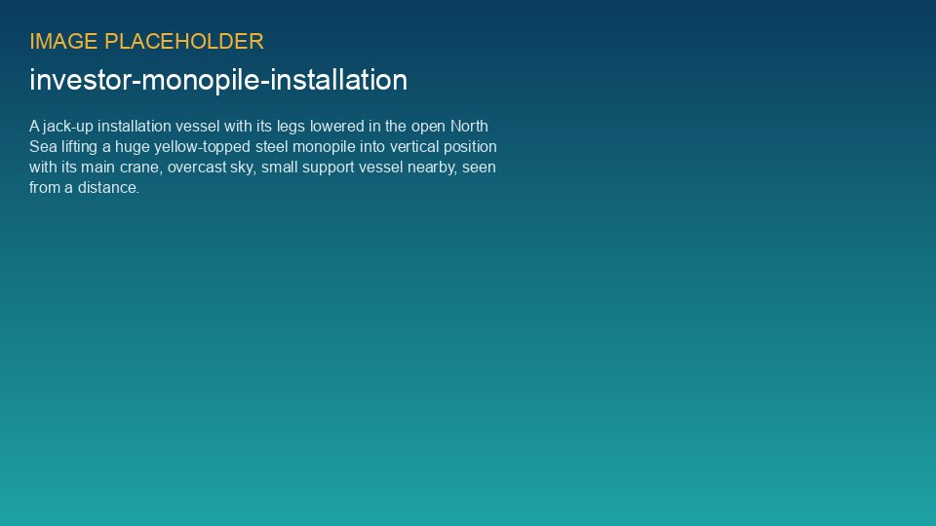
WEYLAND ENERGY
Who will build it – and how long will it last?
Dr. Amara Okafor · North Sea Energy Summit 2026

Slide 2
Build
Supply chains are critical infrastructure

Slide 3
One failed test = 8 weeks
• Factory test did exactly what it should
• Campaign resequenced in days
• Europe needs more cable factories, vessels and ports
WEYLAND ENERGY · Who will build it?
3
Notes:
Thank Elena and the Harrow Bay team – they are in row 3.

Slide 4
Partner
Heavy industry and renewables, building together

Slide 5
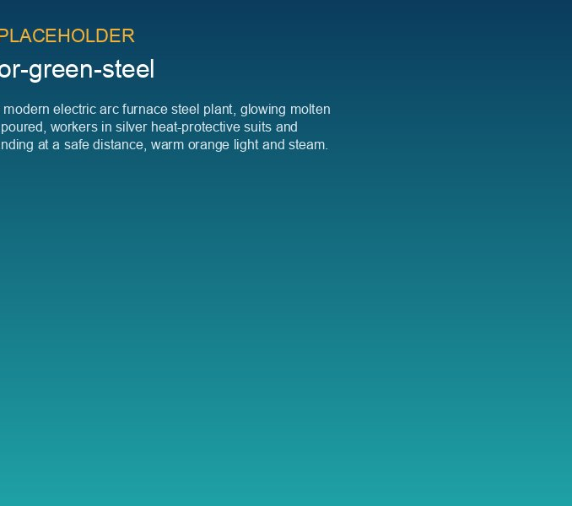
150 MW for green steel
• WE-PPA-2026-004 – 15 years
• ~590 GWh per year from 2028
• 5 MW electrolyser at Port of Eastholm
WEYLAND ENERGY · Who will build it?
5

Slide 6
Last
Neighbours for the whole lifetime

Slide 7
“Every near miss is a gift”
— Pause here.
WEYLAND ENERGY · Who will build it?
7

Slide 8
WEYLAND ENERGY
Clean power, built to last.
Booth B4.210 – come and knock on the steel

